Slide 1
Tidal Power

Slide 2
Working Principle
Tidal energy is produced by the surge of ocean waters during the rise and fall of tides. Tidal energy is a renewable source of energy.

Slide 3
Types OF Tidal Power Plants
Tidal Energy Generators
There are currently three different ways to get tidal energy:
tidal streams:
turbines are placed in tidal streams. A tidal stream is a
fast-flowing body of water created by tides to
generate electricity.
Barrages:
Tidal lagoons:

Slide 4
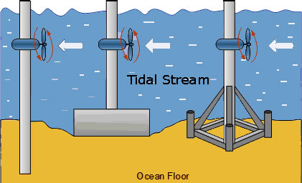
Tidal Energy Streams
Turbines are placed in tidal streams. A tidal stream is a fast-flowing body of water created by tides to generate electricity.

Slide 5
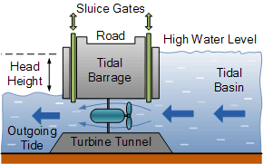
Tidal Barrage
Tidal energy generator uses a large dam called a barrage. With a barrage, water can spill over the top or through turbines in the dam as the dam is low. Barrages can be constructed across tidal rivers, bays, and estuaries.
Turbines inside the barrage harness the power of tides the same way a river dam harnesses the power of a river. The barrage gates are open as the tide rises. At high tide, the barrage gates close, creating a pool, or tidal lagoon. The water is then released through the barrage's turbines, creating energy

Slide 6
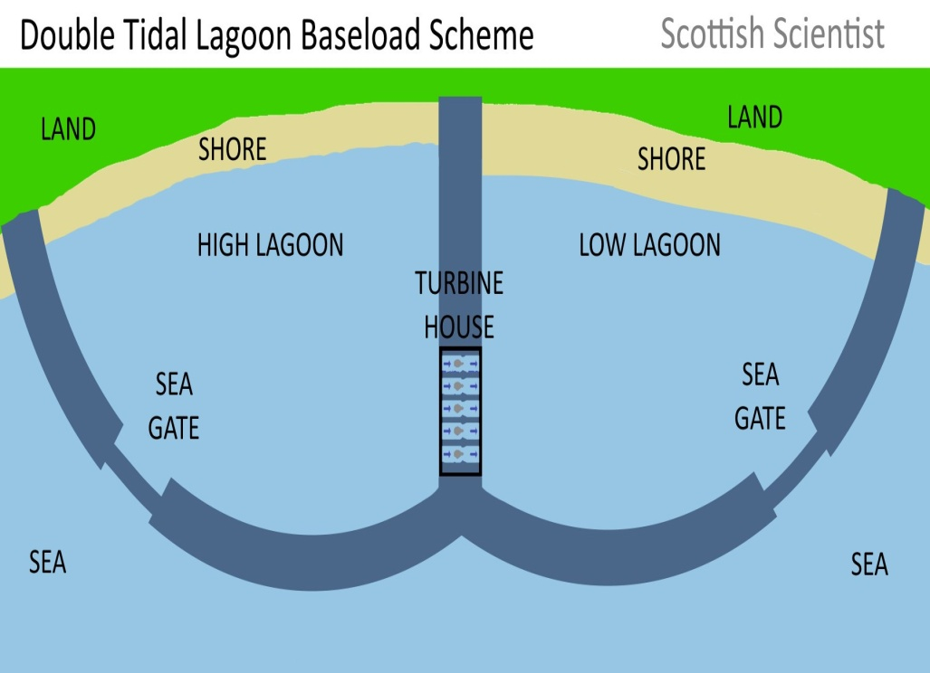
Tidal lagoons:
A tidal lagoon is a body of ocean water that is partly enclosed by a natural or manmade barrier. It may be estuaries with freshwater emptying into them.
A tidal energy generator using tidal lagoons would function much like a barrage. Unlike barrages, tidal lagoons can be constructed along the natural coastline. The turbines work as the lagoon is filling and emptying.
The environmental impact of tidal lagoons is minimal.

Slide 7
Environmental Impacts of Tidal Power Generation
Beside a significant reduction of CO2 emissions, tidal energy also contributes to a reduction in the emission of all other types of greenhouse gas, such as methane (CH4) and nitrous oxide (N2O). These gases are released during the combustion of fossil fuels, such as coal, oil, and natural gas, to produce power

Slide 8
Applications
Tidal electricity:
This is one of the most common uses of tidal power or energy. Technology advancement even focuses more on this usage of tidal energy. The electric power generated from the tides is reliable as the tides are predictable compare to other renewable energy like wind and the sun. tidal energy is also uniform in nature.
Grain mills:
Tidal energy can be used in grain mills for the mechanical crushing of grains. Here, tidal energy is used to rotate a turbine.

